Slide 1
Group 2 Project - Lawndromat
Team Members:
Matthew Bingham - Background Designer
Braeden Grant - Backend Specialist
Joshua Hamby - Scrum Master/Database Handler
Trevor Jex - Frontend/API Specialist

Slide 2
Project Overview
We decided to write the Lawndromat project in Django since most of us were familiar with it, and Trevor felt comfortable with learning it. We elected Josh to be scrum master, and he scheduled meetings for us in the library each Tuesday and Thursday. He also created a Discord server, where we regularly held standup meetings to update one another on our progress. Trevor took the frontend because he was comfortable with HTML as well as other template-based frameworks. Braeden and Josh took backend development and handled the creation and implementation of models, views, and unit tests. Matthew worked on the profile page coloring and design.
The project is ready for deployment as we have fulfilled all of the requirements outlined in our documentation. The system allows customers, workers, and the owner to create accounts, deposit and withdraw funds, and make and fulfill job requests based on location and schedule.

Slide 3
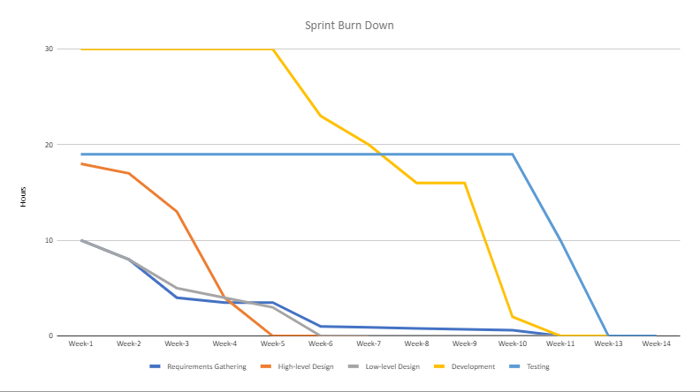
Sprint Burn Down Chart

Slide 4
Requirement 1: User Profiles
Requirements Definition:
System should allow users to deposit/withdraw money from the account
System should allow authenticated users to change username and password
Users can choose to be a worker or customer on account creation
We decided to utilize a 1-1 relationship between Django’s User model and our own user
profiles in order to take advantage of Django’s built-in authentication system while still being
able to implement the custom user specifications needed in our design.

Slide 5
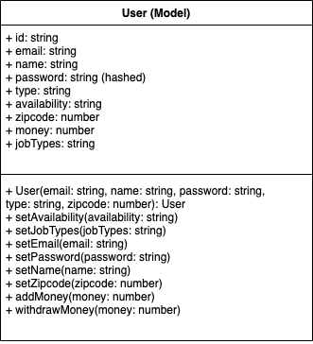
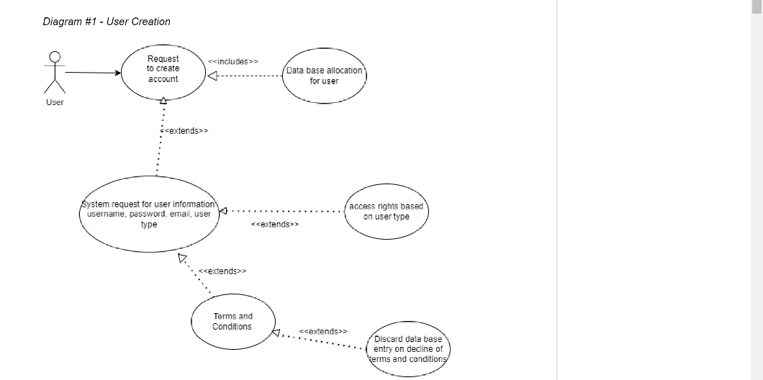
User Diagrams

Slide 6
User Creation Tasks
UserProfile database model
Created by Joshua Hamby and Braeden Grant
User verification (login and logout)
Completed by Braeden Grant
Register page
Created by Trevor Jex
Update user information
Completed by Braeden Grant
Money deposit/withdrawal page
Created by Braeden Grant
Create owner type
Created by Braeden Grant
Unit test for unit profiles
Created by Braeden Grant

Slide 7
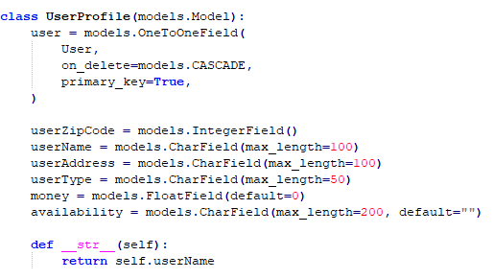
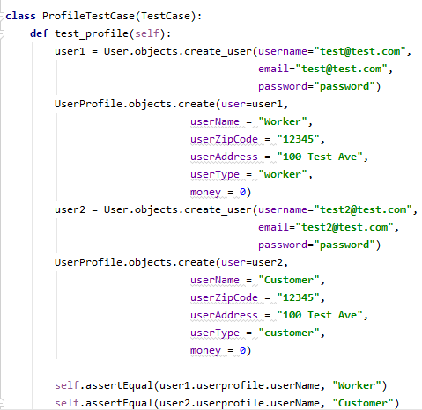
We created a test case in tests.py to verify that our UserProfile model was properly integrated with Django’s built-in user model and information was stored correctly.
Users - Testing

Slide 8
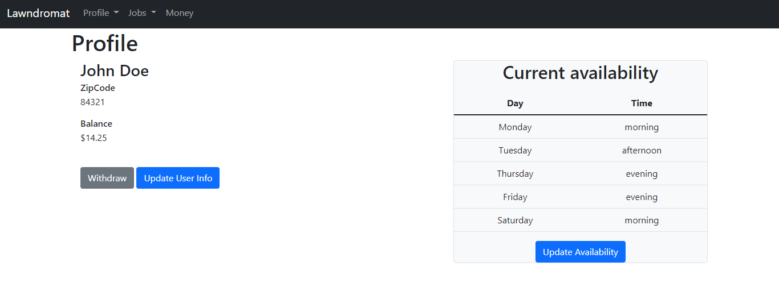
Users - Implementation
Example: user profile page for a worker

Slide 9
Requirement 2: Job Completion
Requirements Definition:
Workers will have access to current customer request information and will be able to mark a request as complete.
Customers will be able to give feedback on their past requests
Workers will be able to see customer feedback on their completed jobs.
The worker is able to mark the job as complete, which is when payment is made to the worker and to the owner. Payment from the customer happens on job creation (a separate feature, not described here).
The customer is able to leave either a Thumbs Up or Thumbs Down, as well as a text comment with more detail. The worker is able to see all of this information for their completed jobs.

Slide 10
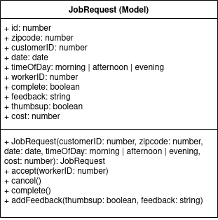
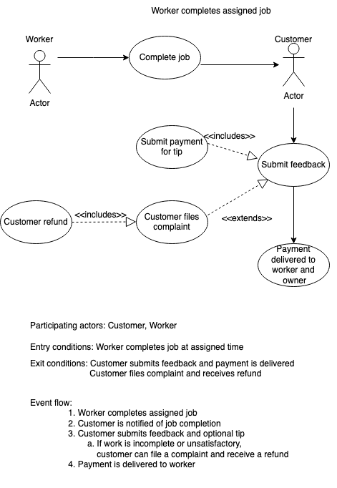
Job Completion Diagrams
This is our original use case diagram. We ended up not implementing the refund or tip feature and left those as future features. We also changed the payment flow.
The JobRequest model and User model are both touched by the job completion code.

Slide 11
Job Completion Scrum Tasks
Create view individual request page
Trevor Jex
Create job completion form in the frontend
Trevor Jex
Create job completion logic in the backend (handle payment)
Trevor Jex
Create feedback submission form in the frontend
Trevor Jex
Create feedback submission logic in the backend
Trevor Jex

Slide 12
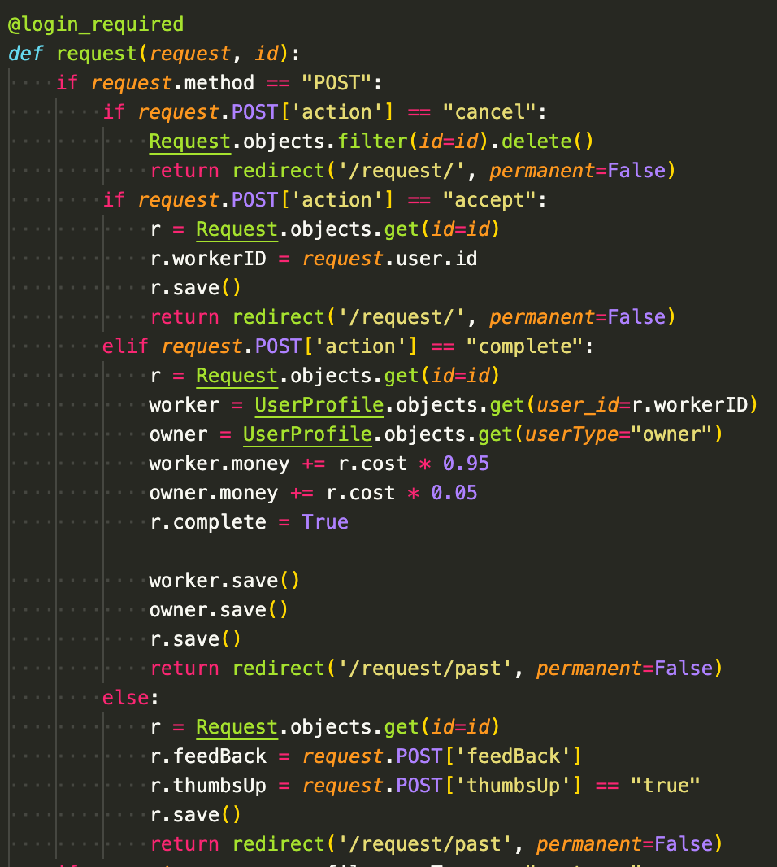
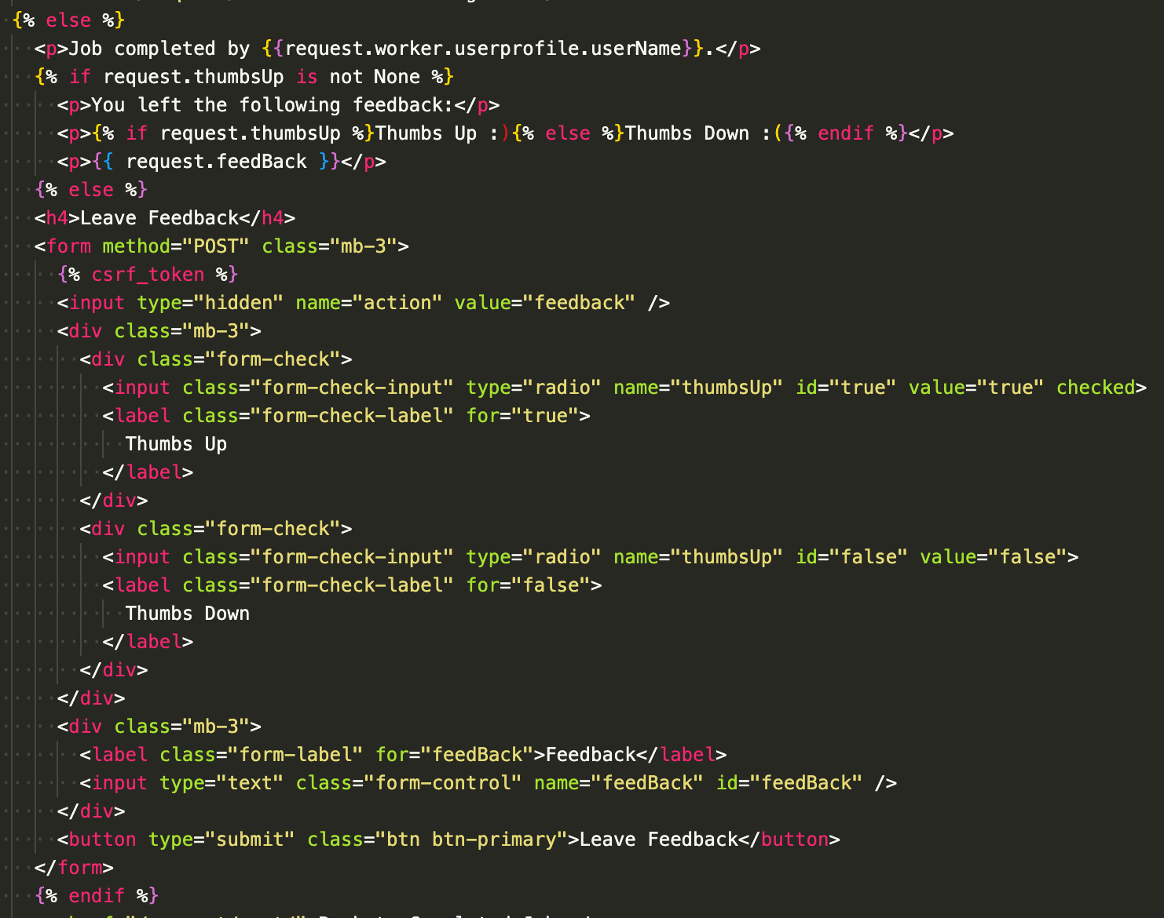
Job Completion Code
This is the Django backend code for the request page. As well as handling job completion, it handles job acceptance and cancellation as well.
This is a small portion of the frontend template code. This particular piece displays the feedback form for a customer’s completed job, or displays their feedback if they’ve already given it.

Slide 13
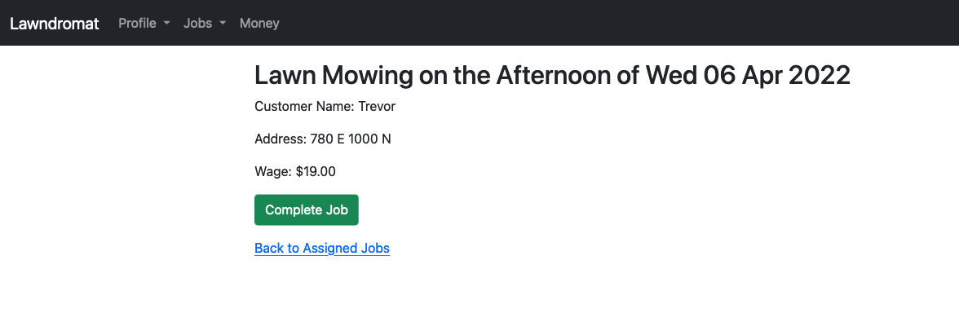
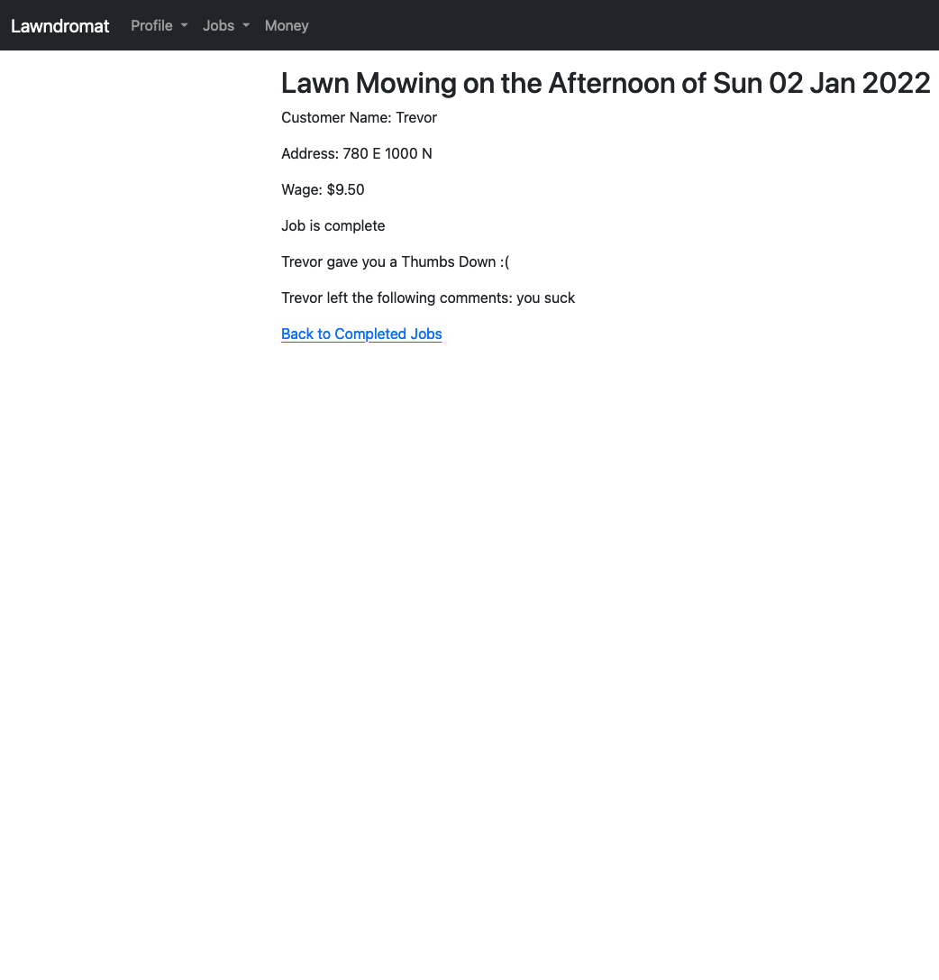
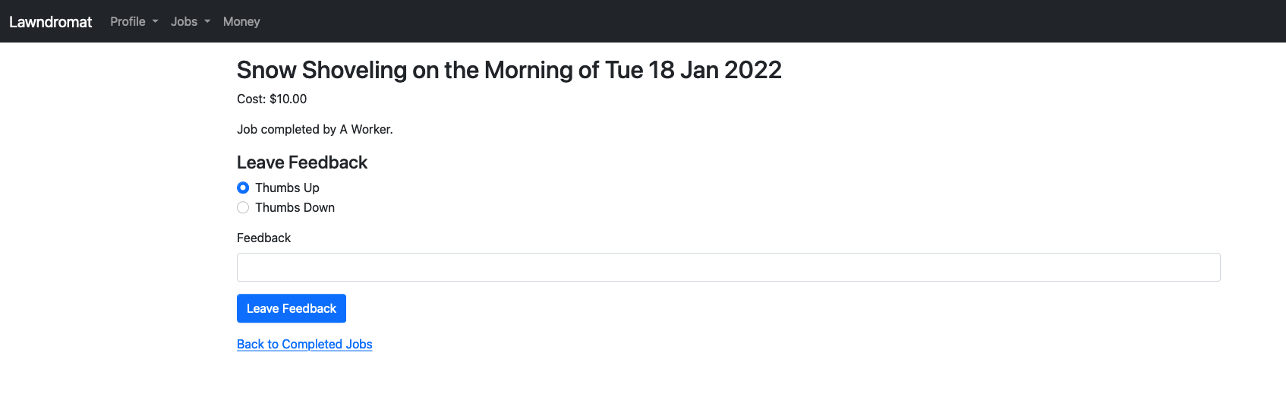
Job Completion Implementation

Slide 14
Requirement 3: Worker Availability
Requirements Definition:
Workers will have access to change their availability.
Requests filter based on worker availability.
We decided that the worker profile type should have access to a data type called availability. Availability is important as it allows workers to select specific times they are available to accept job requests. Job requests will be filtered based on worker availability.

Slide 15
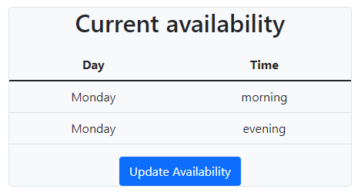
Worker Availability Design
Worker Availability was designed so that Requests made by the customers would filter to different workers based upon the date the customer chooses. The request would then filter to the workers that are available that day.
We also decided created availability to be generalized into time frames of morning, afternoon and evening.

Slide 16
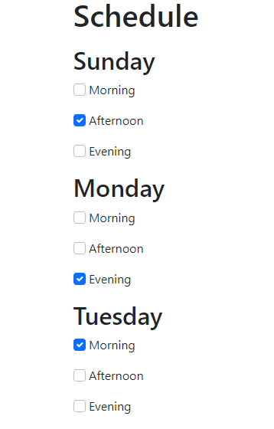
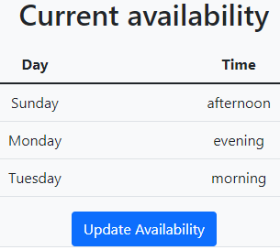
Updating Worker Availability

Slide 17
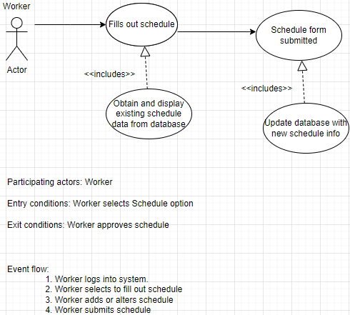
Worker
availability
Use Case diagram

Slide 18
Worker Availability Scrum Tasks
Create Profile Page
Joshua Hamby & Matthew Bingham
Create Home Page / Work on profile page
Joshua Hamby
Update Worker availability
Joshua Hamby & Braeden Grant

Slide 19
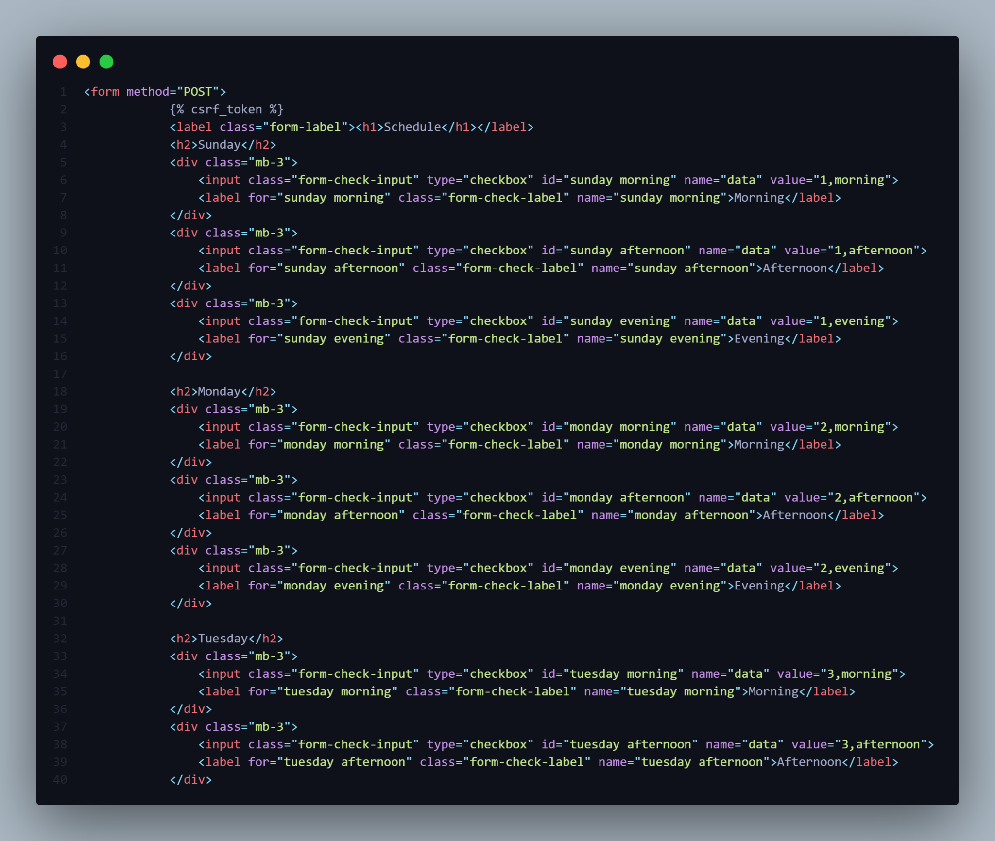
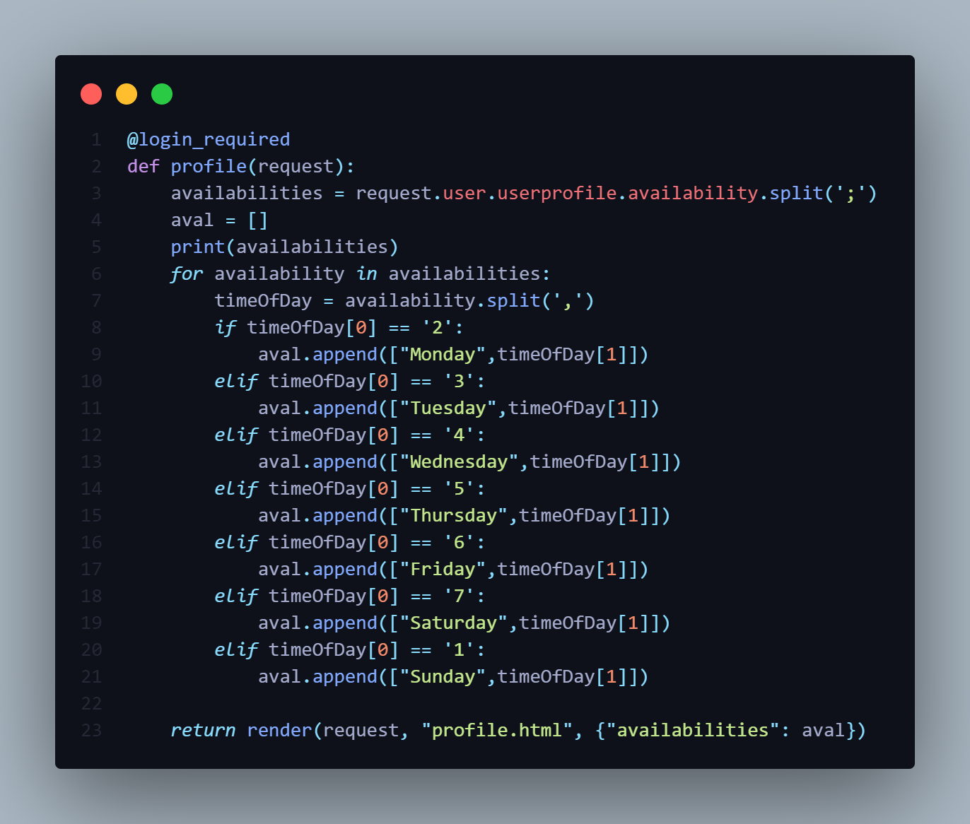
Worker Availability Code

Slide 20
Use Case Demonstration Videos
User Creation
Login
Submit Job Request
Adding/Withdrawing Money

Slide 21
Resources
Django documentation. (n.d.). Django Project. Retrieved April 5, 2022, from https://docs.djangoproject.com/en/4.0/
Otto, M. J. T. (n.d.). Bootstrap Documentation. Bootstrap. Retrieved April 5, 2022, from https://getbootstrap.com/docs/5.1/getting-started/introduction/
How to Write Effective Use Cases? (2016, January 27). How to Write Effective Use Cases. Retrieved April 5, 2022, from https://www.visual-paradigm.com/tutorials/writingeffectiveusecase.jsp
Diagram Software and Flowchart Maker. (n.d.). Diagrams.Net. Retrieved April 7, 2022, from https://www.diagrams.net/
Dixon and Moe. (n.d.). HTML color codes. HTML Color Codes. Retrieved April 11, 2022, from https://htmlcolorcodes.com/

Slide 22
Questions?

